Slide 1
Year 3
Leopards

Slide 2
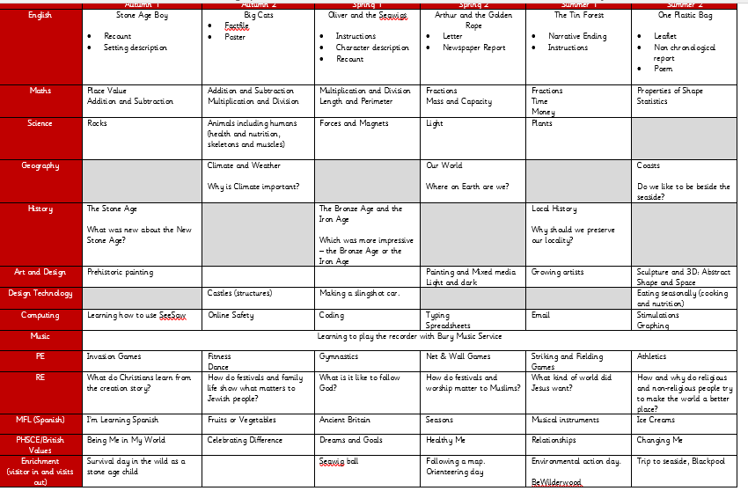
Yearly overview
This can be found on the class page and in the documents you can take with you today.
This is a general overview of topics we will be looking at this year.
The English overview will be changing soon and the books they read will be different. Updates will be on the website soon!
Please note there may be some changes to the above during the year, I will keep you posted via the website.
\

Slide 3
School values and rules
EMPATHY
RESPECT
INDEPENDENCE
COURAGE
CURIOSITY
BE READY
BE RESPECTFUL
BE RESPONSIBLE

Slide 4
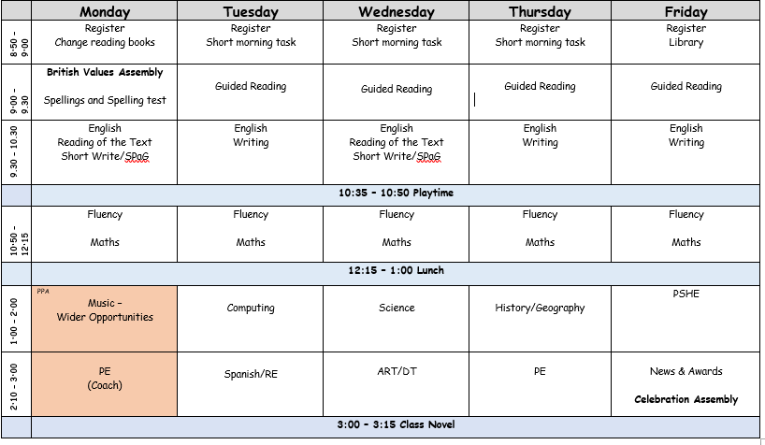
What has changed?
New timetable – Lunchtime and playtimes are later. During the afternoons where we have PE the children may not get an afternoon playtime.
Monday afternoon is my PPA this is when the children have PE and recorders. I will still respond to emails during school hours on Mondays.
Packed lunches/ snacks and drinks. -Children can bring their own healthy snack for morning playtime as long as it does not contain nuts. This must be in their book bags.
Packed lunches also have to be nut free, if children do not like sandwiches alternatives are fine.
Spellings - Children will have a spelling test every Monday morning and they will see their results the following Monday in their books. I will start to highlight the statuary spelling words, these words are the most important from the list of spelling rules.
Reading books and library - changed every Monday. Children may move up multiple levels in the year. · Children will have the chance to take out a library book in the new year. They will be expected to renew them or change them weekly. Any damages or loss of books will be charged.
Recorders/Music lessons – Some music lessons are during Maths and English times in the week.
Friday Assembly – New time of 2:45
Please note there may be some changes to the above during the year, I will keep you posted via the website.
Enrichment - During the year we will have lots of different opportunities for the children to take part in some enrichment activities. Some may require a voluntary contribution, we would appreciate all your support with this.
Some activities include:
A day outdoors as a Stone Age child.
A seawig ball
BeWILDerwood
A trip to the seaside
Environmental action day.

Slide 5
Using SeeSaw and the website
Parents have access to their child's work.
Children will have a log in from home where they can upload work or complete activities (spellings/completing work) – This is not compulsory homework.
Most updates will be via SeeSaw and the website will be updated every half term.
Overviews/ letters and official class updates will be uploaded to the website as well as SeeSaw.

Slide 6
Contacting me
I will respond to emails during my working hours Monday to Friday.
I will always try my best to be open and honest including raising any concerns regarding academia, behaviour and friendships.
Any time off will need to go directly to the school office.
When you have appointments either myself or the school office need to be informed. You will be asked to provide proof of appointment at the office.

Slide 7
If you have any questions please email me via the contact your class teacher area on the website.

