Slide 1



Phonics

Slide 2


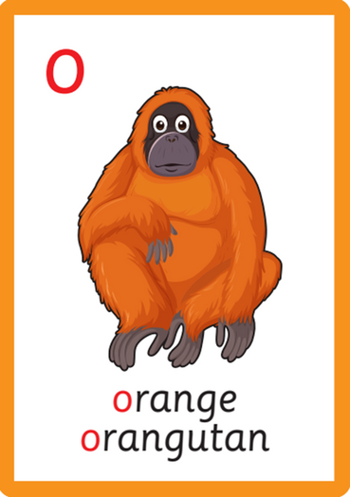

What is phonics?

Slide 3
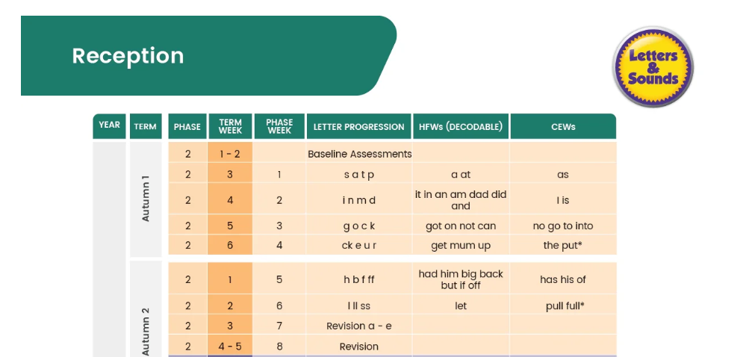
Progression

Slide 4
Term | What it Means | Example
Phoneme | A phoneme is the smallest unit of sound in a word. | cat has 3 phonemes: c – a – t
Grapheme | The written letter or group of letters that represents a sound. | The sound /ai/ can be written as ai (rain) or ay (day)
Decoding | Reading: looking at the letters and saying the sounds to work out the word. | Reading: c-a-t → cat
Blending | The process of pushing the sounds together to read the word. | “Say the sounds and blend: p-i-n → pin”
Encoding | Spelling: listening for the sounds and writing down the letters to match. | Hearing dog and writing d-o-g
Digraph | Two letters that make one sound. | sh, ch, th, ee, oo
Trigraph | Three letters that make one sound. | igh in night, ear in hear

Slide 5
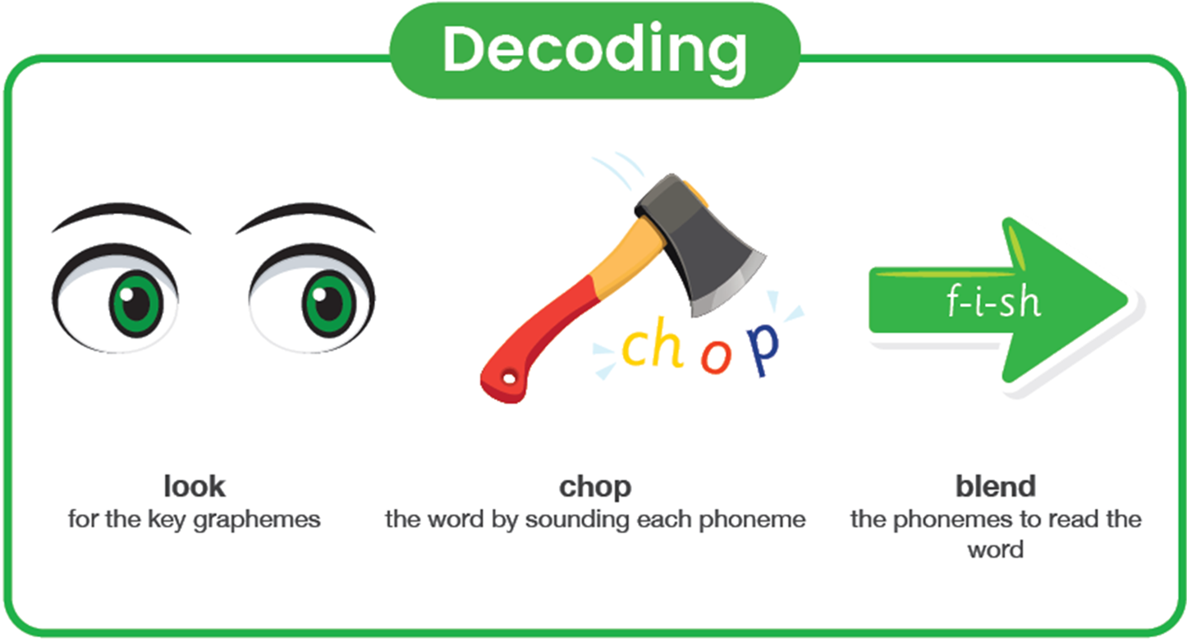
Decoding for reading

Slide 6
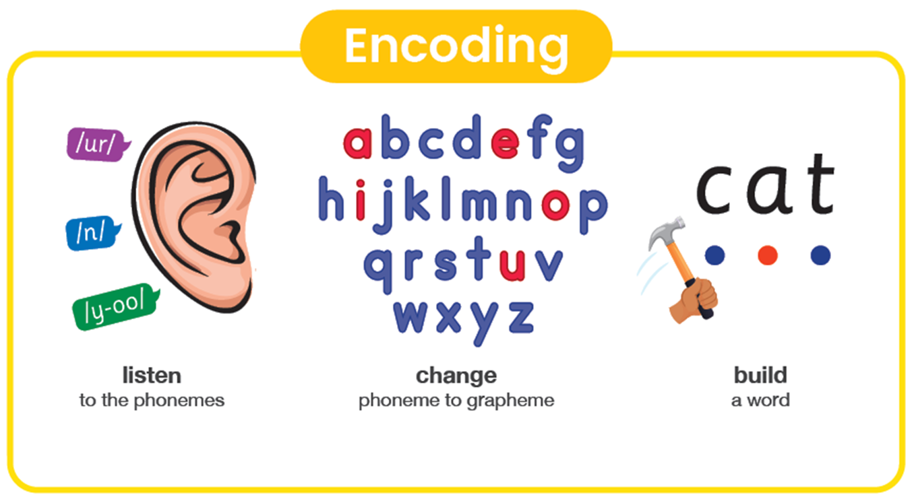
Encoding for spelling

Slide 7
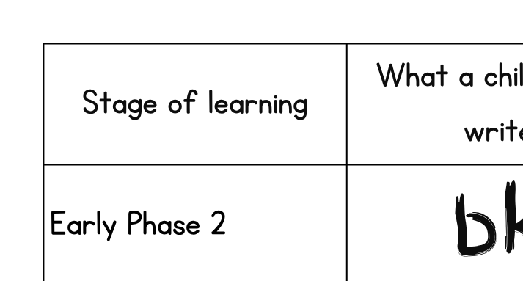
Encoding for spelling

Slide 8
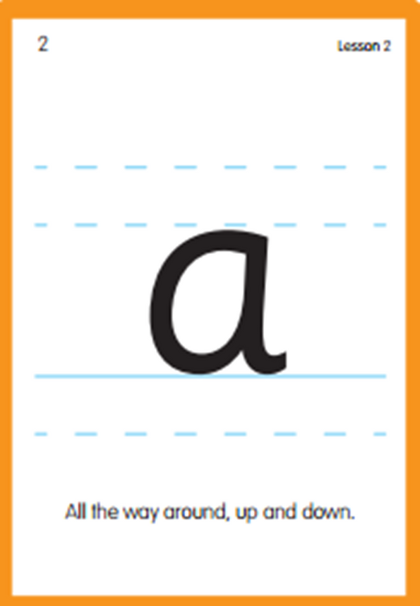
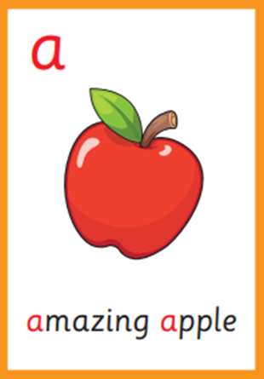
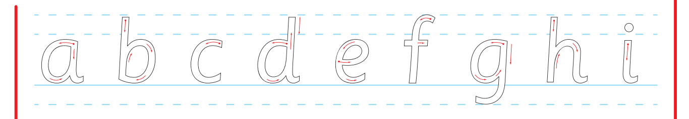
Letter Formation

Slide 9
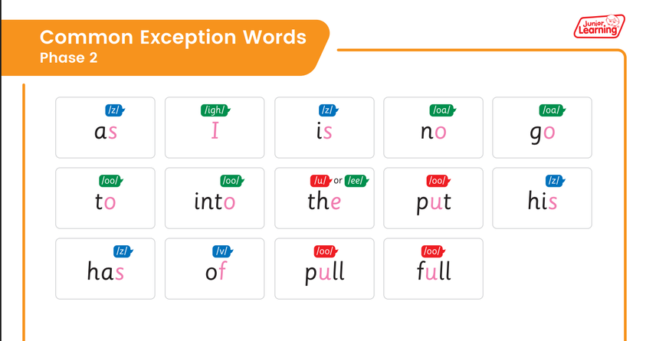
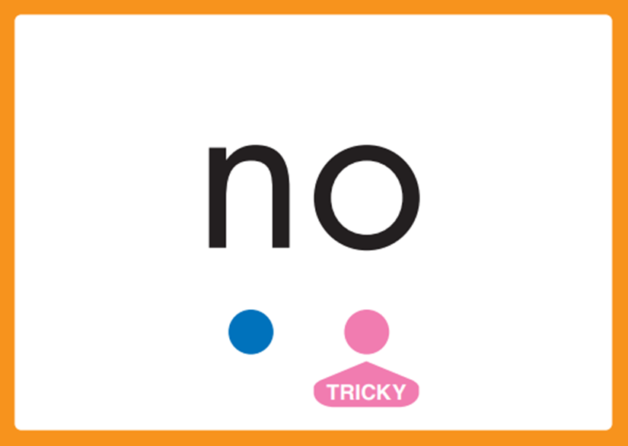
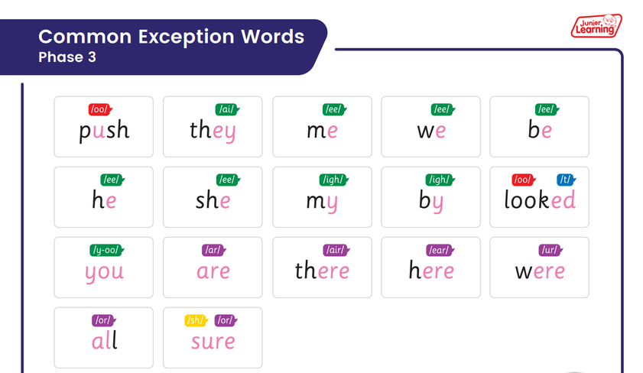
Tricky Words

Slide 10




Reading at Home

Slide 11

Reading at Home
  Just 5 minutes a day is enough
  Little and often
  Finding the right moment in your day is key
  The most important thing is consistency

Slide 12

A cat in the bath.

Slide 13




Please make sure your child has:
· Their decodable reading book
· Their library book
· Their reading diary
· Their phonics book
in school every day.

