Slide 1
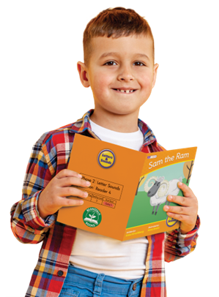
Home Reading
Support for Parents

Slide 2
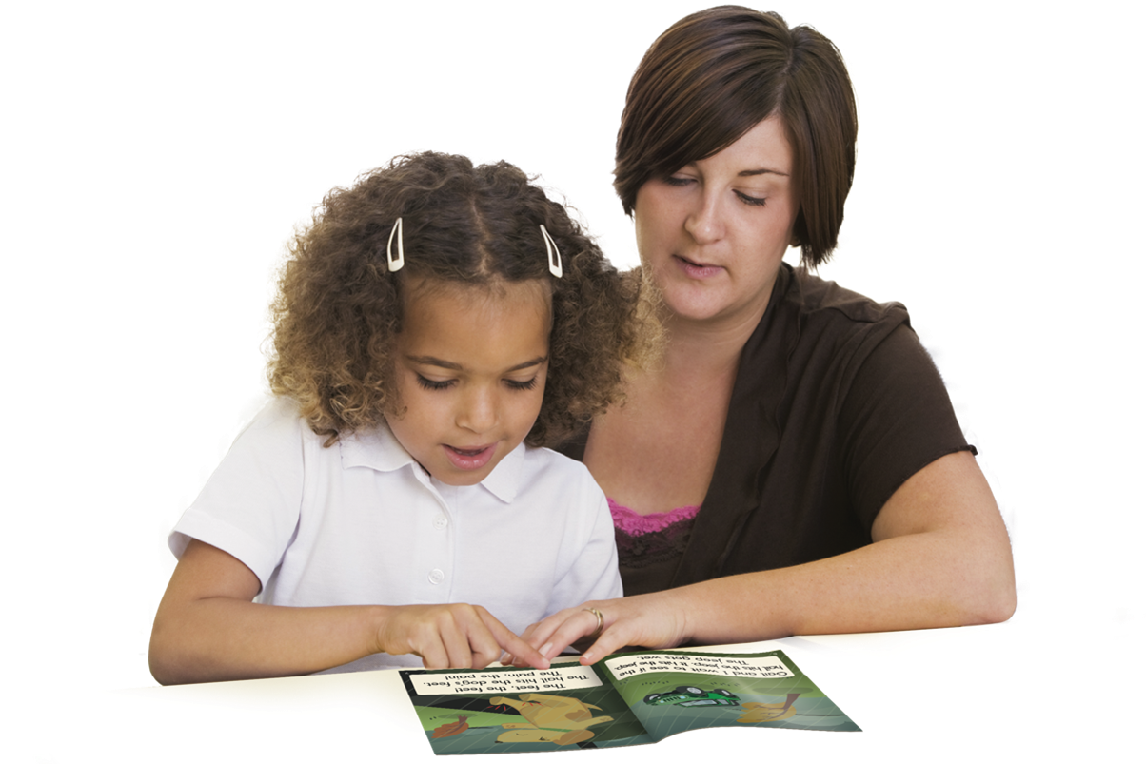
What should I write in my child’s Reading Record Book?

Slide 3
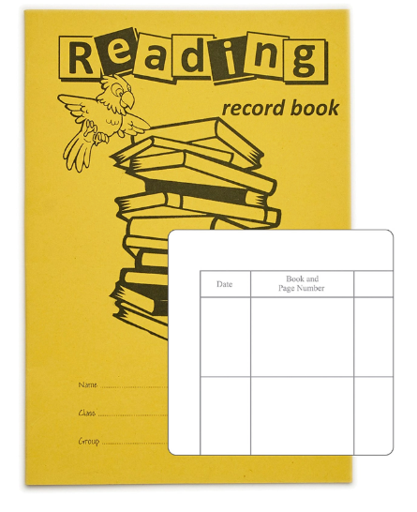
When your child brings a book home from school, they usually will receive a Reading Record Book alongside it too.
The Reading Record is a place for you to record the read and schools will invite you to make a comment.
But what can I write?

Slide 4
You many receive two types of reading book home over the course of a week and maybe asked to keep the same book for a few days at a time.
Decodable Reading Book
This book is closely matched to your child’s current reading ability. Children should be secure with the graphemes (letters) within the book and be able to read the book almost fluently (no need to ‘sound out’ most of the words)
2. Story/Library Book
This book is to share together. This is to develop a love of reading.
Your child will NOT be expected to read the words in this by themselves.

Slide 5
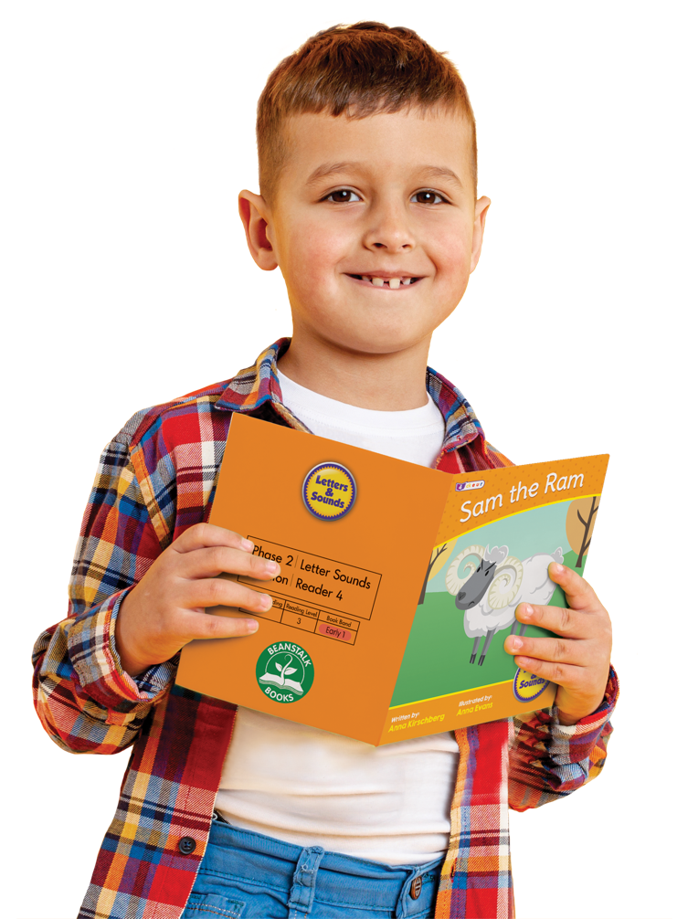
Decodable Reading Book
This book is matched to your child’s reading ability.
If you have this book for a few days, you could make a comment for each read based on a different skill.
Read 1 Phonics Skills – Is your child able to sound out the letters and blend the letters together to read a word. Make a comment.
Read 2 Fluency Skills – Is your child able to read most words without needing to sound out words, can the read some words automatically? Make a Comment
Read 3 Comprehension – Is your child able to tell you all about the book with understanding of characters, setting and events. Make a comment

Slide 6
The Reading Record book is your chance to communicate to the teaching staff and tell them how your child got on with the book. If you can be specific with your comments, then it will help staff ensure the decodable books are closely matched to your child’s reading ability.

Slide 7
But what can I write?
Here are some examples….
Max stopped to sound out the word … (Insert word)
Max read most of the words fluently except the word … (Insert word)
Max struggled to blend the word … (Insert word)
Max recognised tricky word … (Insert word)
Max read (insert word) wrong but then corrected himself.
Max read the book confidently and independently.
Max is using expression in his voice.
Max read the book a second time with more speed and pace.
Max can tell me about the characters in the story
Max is able to predict what might happen next.
Max struggled to read this book.

Slide 8
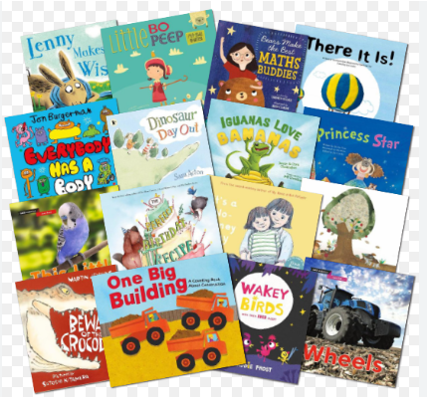
Story / Library Book
Here are some examples….
Max loves The Gruffalo, we have read this book a lot at home, I’m not surprised he chose it to bring home.
Max’s Grandad read this book with him at bedtime.
Max loves stories at bedtime.
Max likes it when I read him a story it’s our quiet time together.
Max could make some predications about the book just by looking at the front cover.
Max and I read his library book at the swimming baths whilst his sister had a lesson.

Slide 9
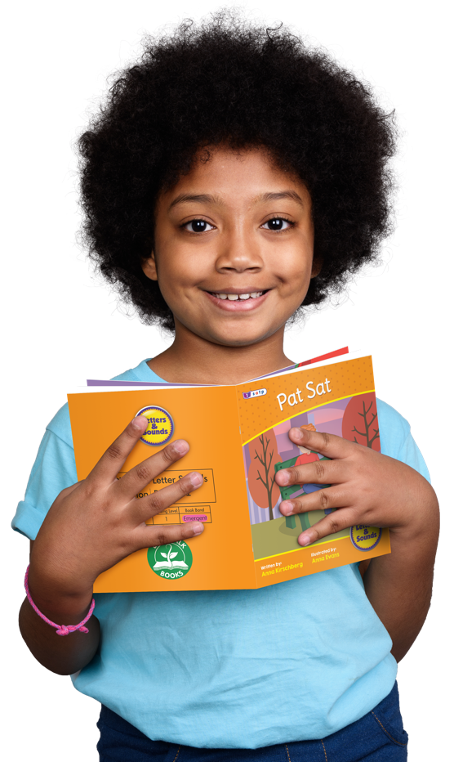
Reading with your child is one of the greatest gifts parents can give. By starting the journey of building a lifelong love of reading for pleasure, parents are giving their child the opportunity to be the best they can be.
Children who read for pleasure do better in a wide range of subjects at school and it also positively impacts children’s wellbeing.

