Slide 1
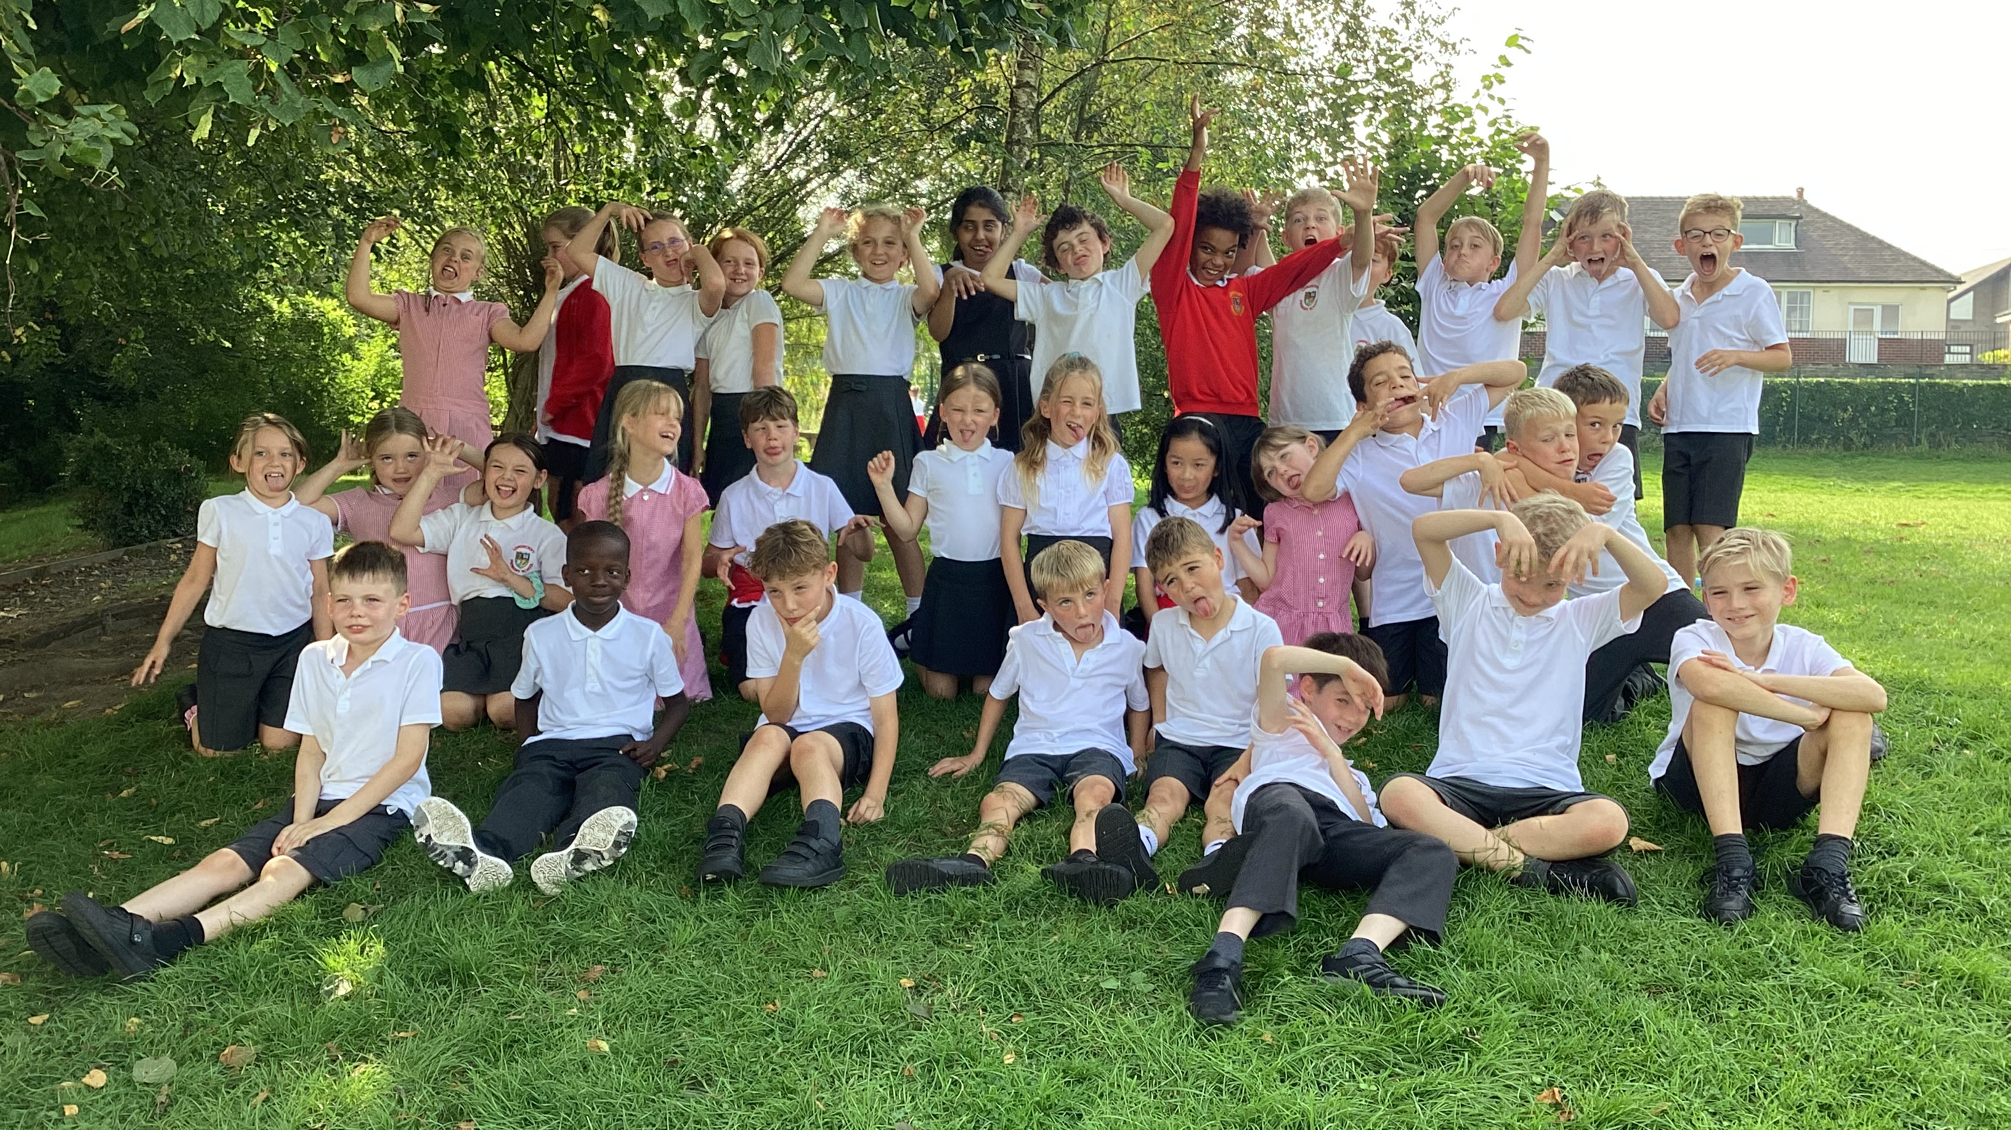
Welcome to Year 4
The Penguins!

Slide 2

Meet the staff…
Mrs Greenwood
Mrs Mann
Mrs Cook (SSA)
Mrs Elkinson (Violin Teacher)
Mr Toth (current PE coach)

Slide 3

Our School Values
Empathy
Respect
Independence
Courage
Curiosity

Slide 4
Our School Rules
Be ready
Be responsible
Be respectful

Slide 5


Slide 6
Rewards…
House points - awarded for behaviour and school work
Secret student – awarded daily to help earn a class treat!
Certificates – presented in our whole school Celebration Assembly

Slide 7
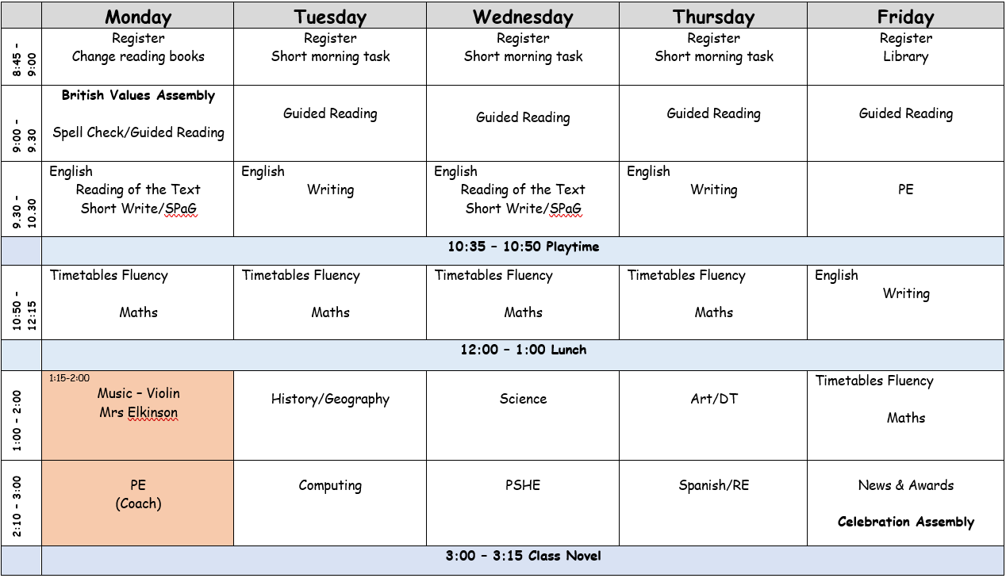
PE days – Monday & Friday
Reading books - Mondays
Library – Fridays
Spell Check - Mondays

Slide 8
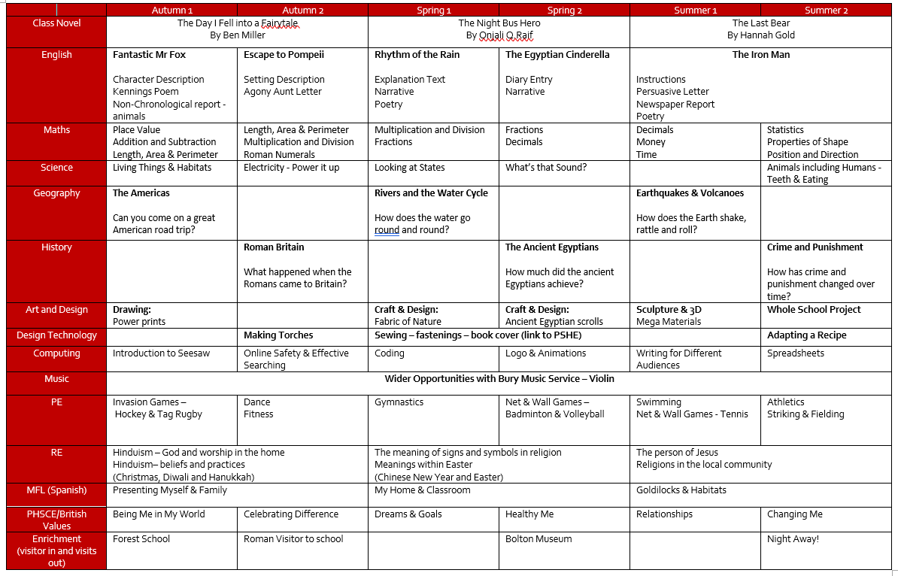

Slide 9
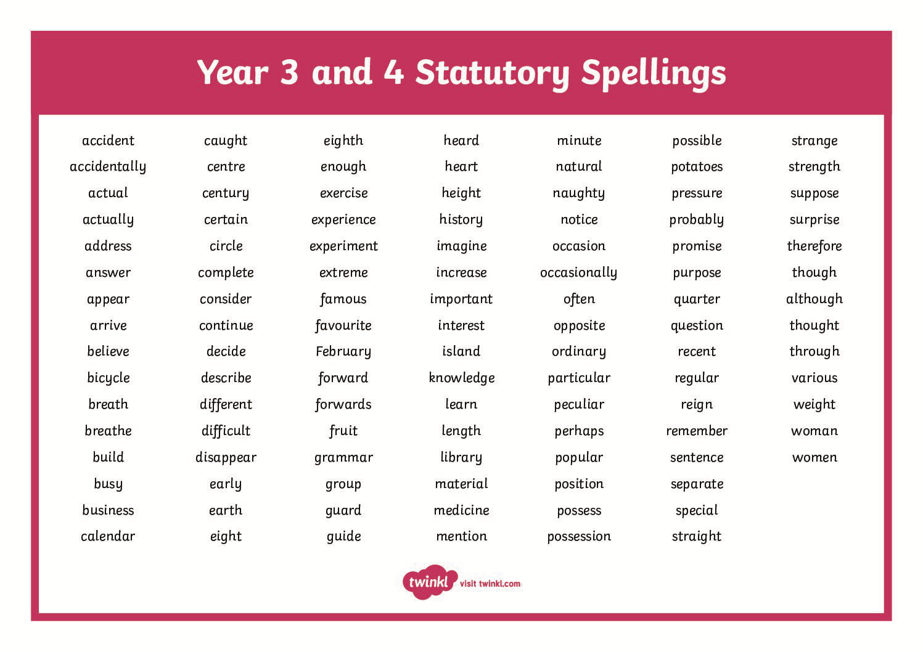
Spellings...
New spellings are introduced on a Tuesday and the spell check takes place the following Monday.
We practise daily in class, focussing on the spelling rule as well as the actual spelling of each word.
All children move onto the next spelling rule.

Slide 10



Times Tables…
Year 4 Statutory Multiplication Check – Summer Term
We encourage all children to regularly practise times tables at home to build automaticity and confidence.

Slide 11




What to look forward to…
Violin lessons
Forest school
Swimming – Summer 1
Night away - TBC

Slide 12
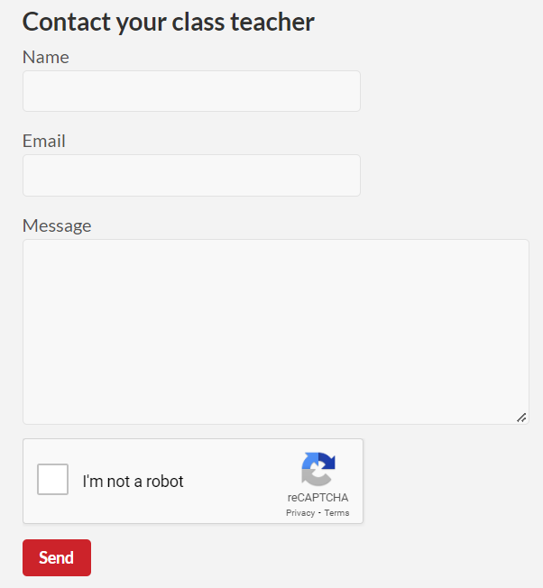
Communication…
Seesaw
Class page
Texts/Emails
Before/after school
Telephone

Slide 13
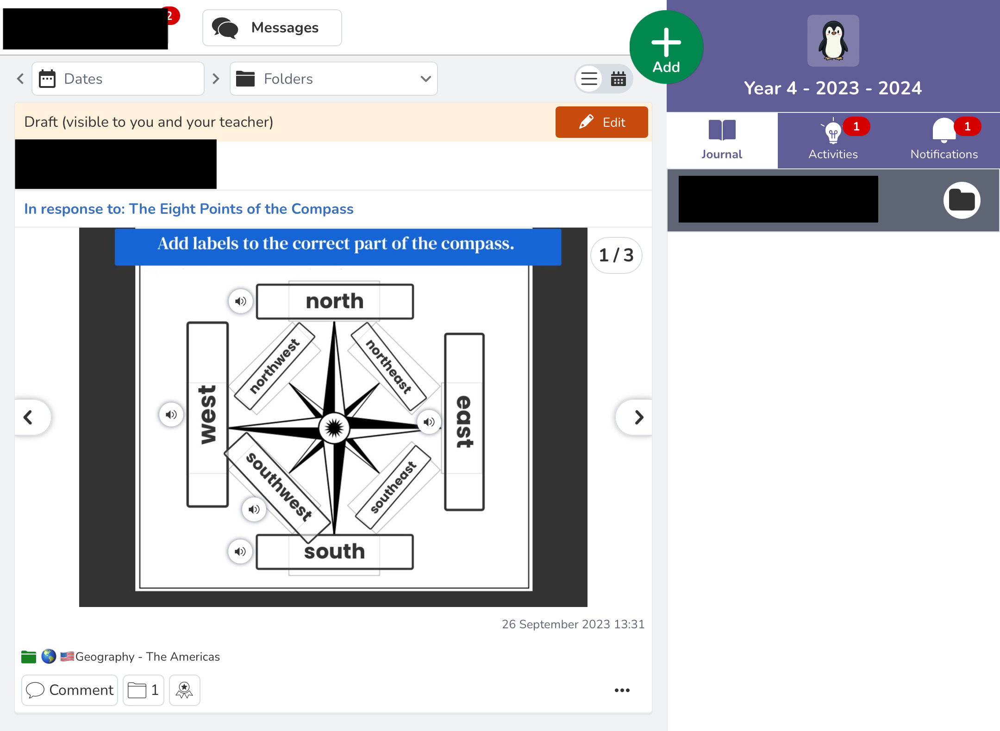

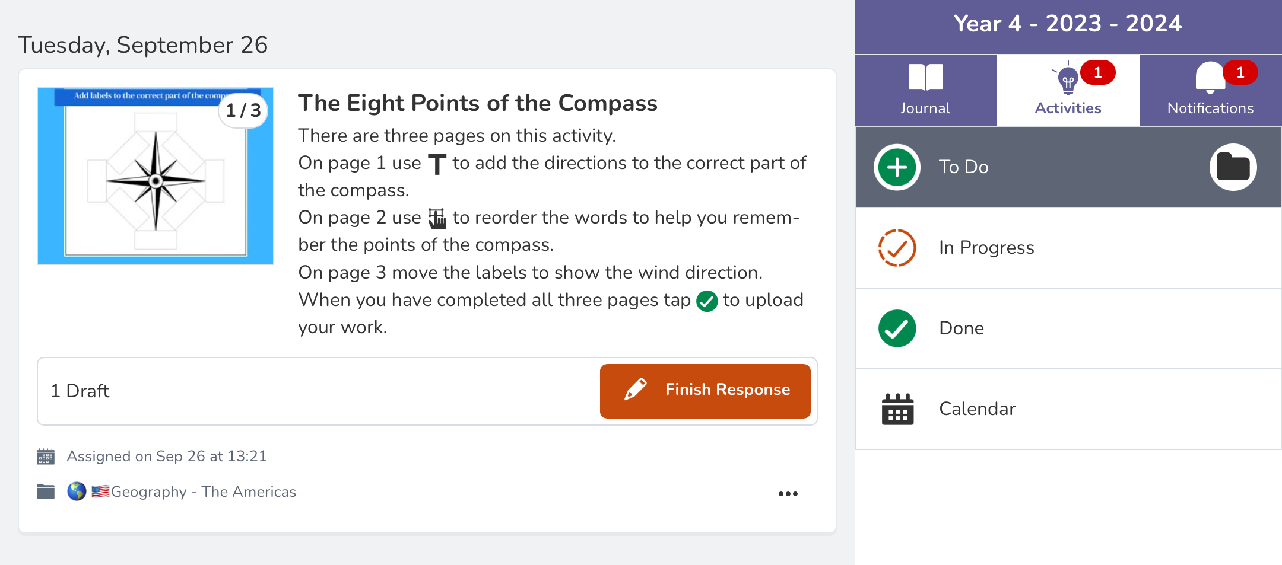
Seesaw will keep you up to date with what is happening in the classroom.
Children will be set home learning tasks they can complete and send back to me.

Slide 14


