Slide 1

New parents’ meeting
June 2024

Slide 2

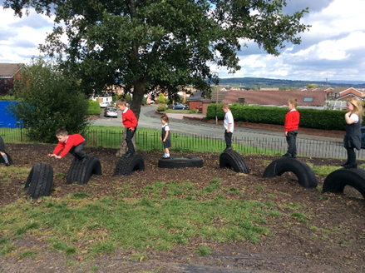
Welcome
Welcome to Lowercroft Primary School
Introductions
Starting in Reception
Year 6 House Captains

Slide 3
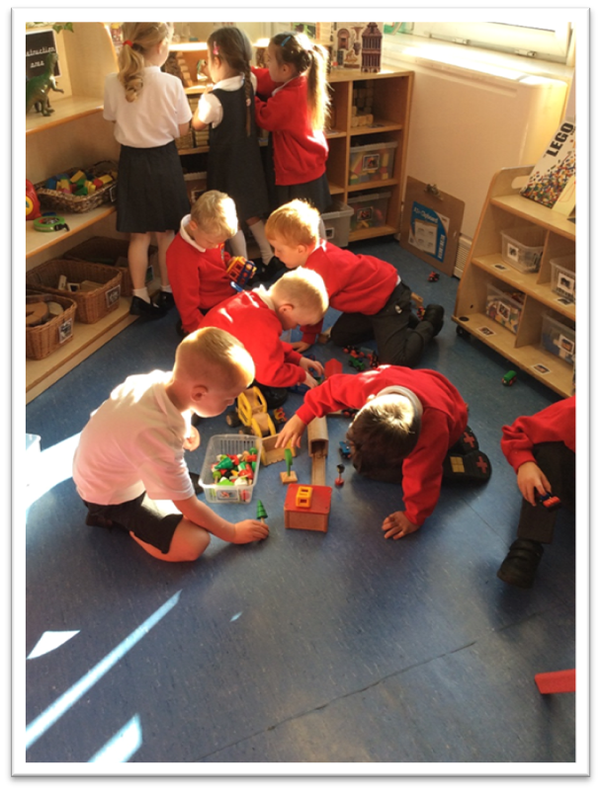
Who’s who?
Mrs Farr and Mrs McGadie – Headteachers
Mrs Kay – Acting Deputy Headteacher
Mrs Parkinson - SENCo
EYFS Lead and Reception Class Teacher – Ms Tattersall
Higher Level Teaching Assistant– Mrs Thompson
Miss Sylvester – Teaching Assistant

Slide 4

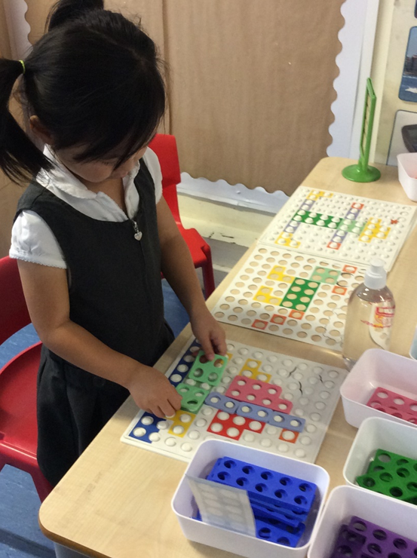
Finishing nursery
Try not to worry!!!
Reception staff will visit your child in their current setting
A stay and play session in June for you and your child (no uniform required)
An optional home visit from Reception staff in September

Slide 5
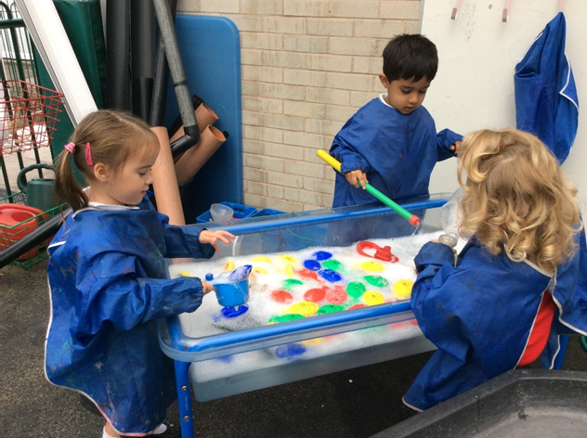
Starting school
A half day, morning or afternoon in September (in uniform)
First full day in Reception is Monday 9th September
The Reception class door is open from 8.45 a.m. Outside area door
Home time is 3:10 p.m. from the classroom side door
Please inform the school if another adult is picking up your child
Share your password with the adult picking up your child

Slide 6
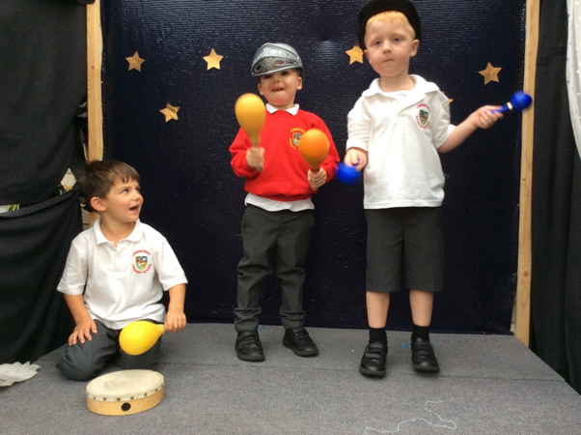
Being ready for school
Being independent- Here are some of the key skills that will help your child to be ready for school;
Dress and undress themselves (within reason)
Use the toilet independently and ask to go there
Help to tidy up
Recognise their own name
Share toys and equipment
Take turns
Sing some nursery rhymes

Slide 7
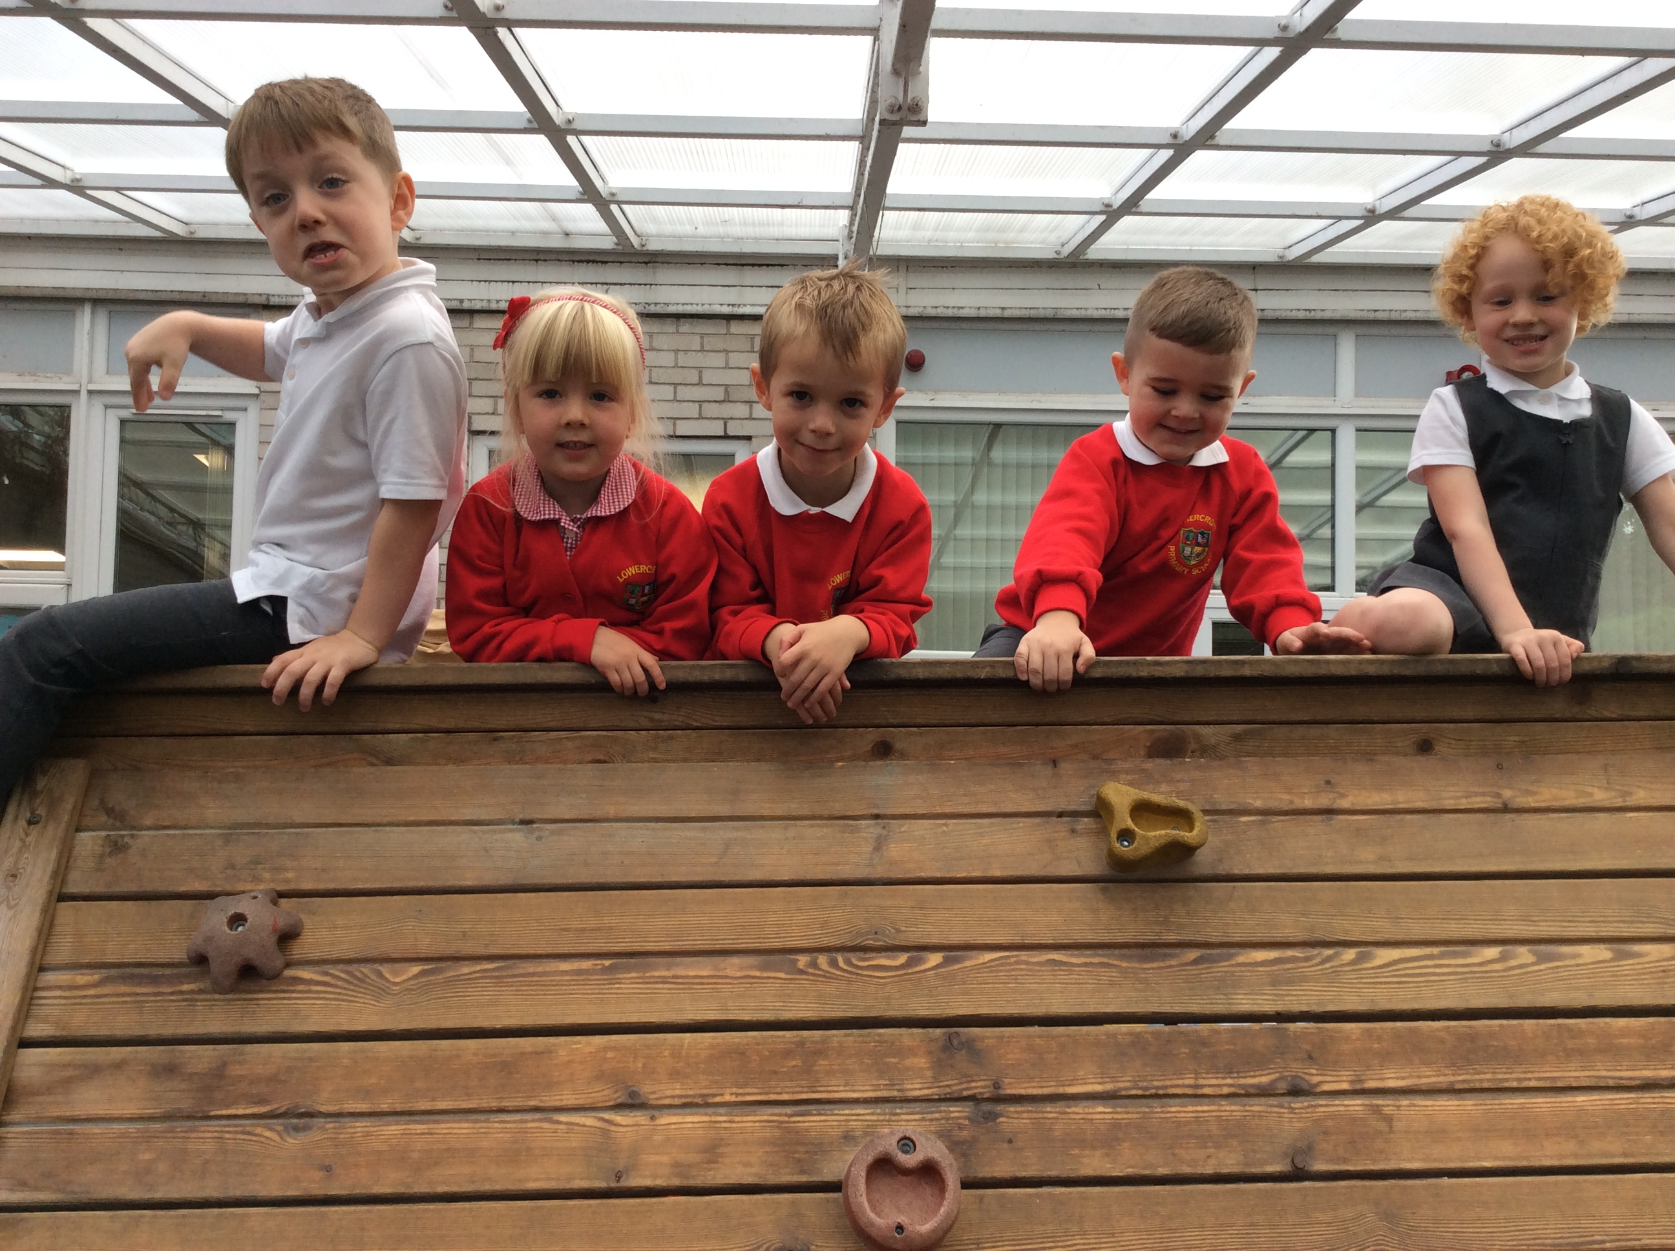
checklist
You need to bring with you:
Reading bag
Water bottle
Coat
Lunchbox (if required)
The following items will remain in school:
PE kit in a named bag
Wellies
Colouring book
Please make sure all your child’s items are clearly labelled with their name!

Slide 8
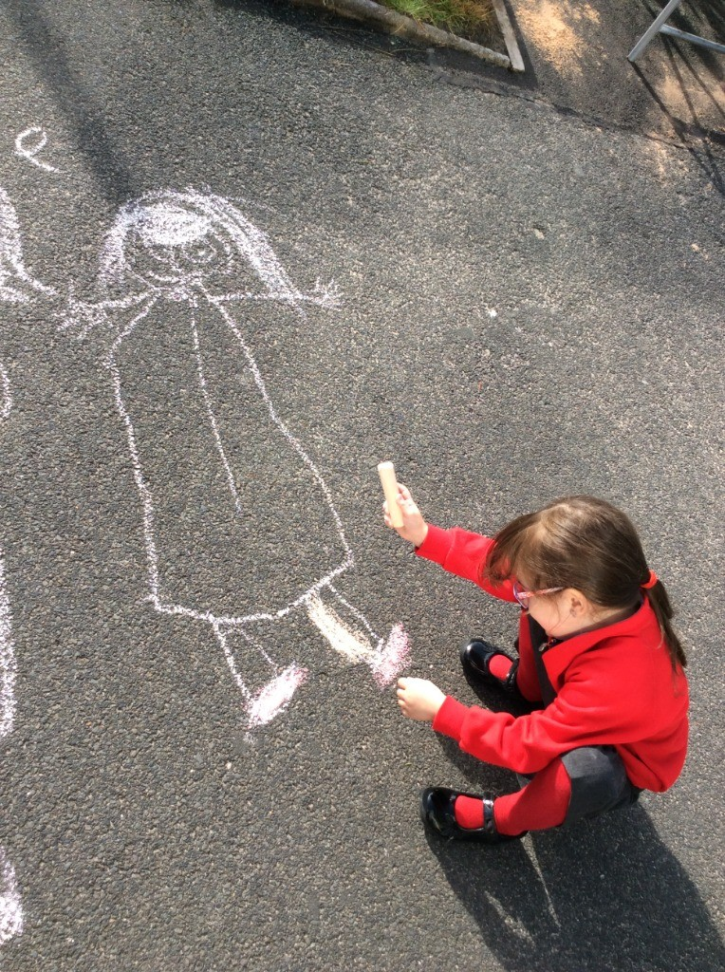
Once in school
During the first few weeks staff will observe and work closely with your child to complete our own baseline assessments
A statutory assessment given to all reception children in England.
A series of maths and phonics questions delivered in school by the reception class teacher

Slide 9
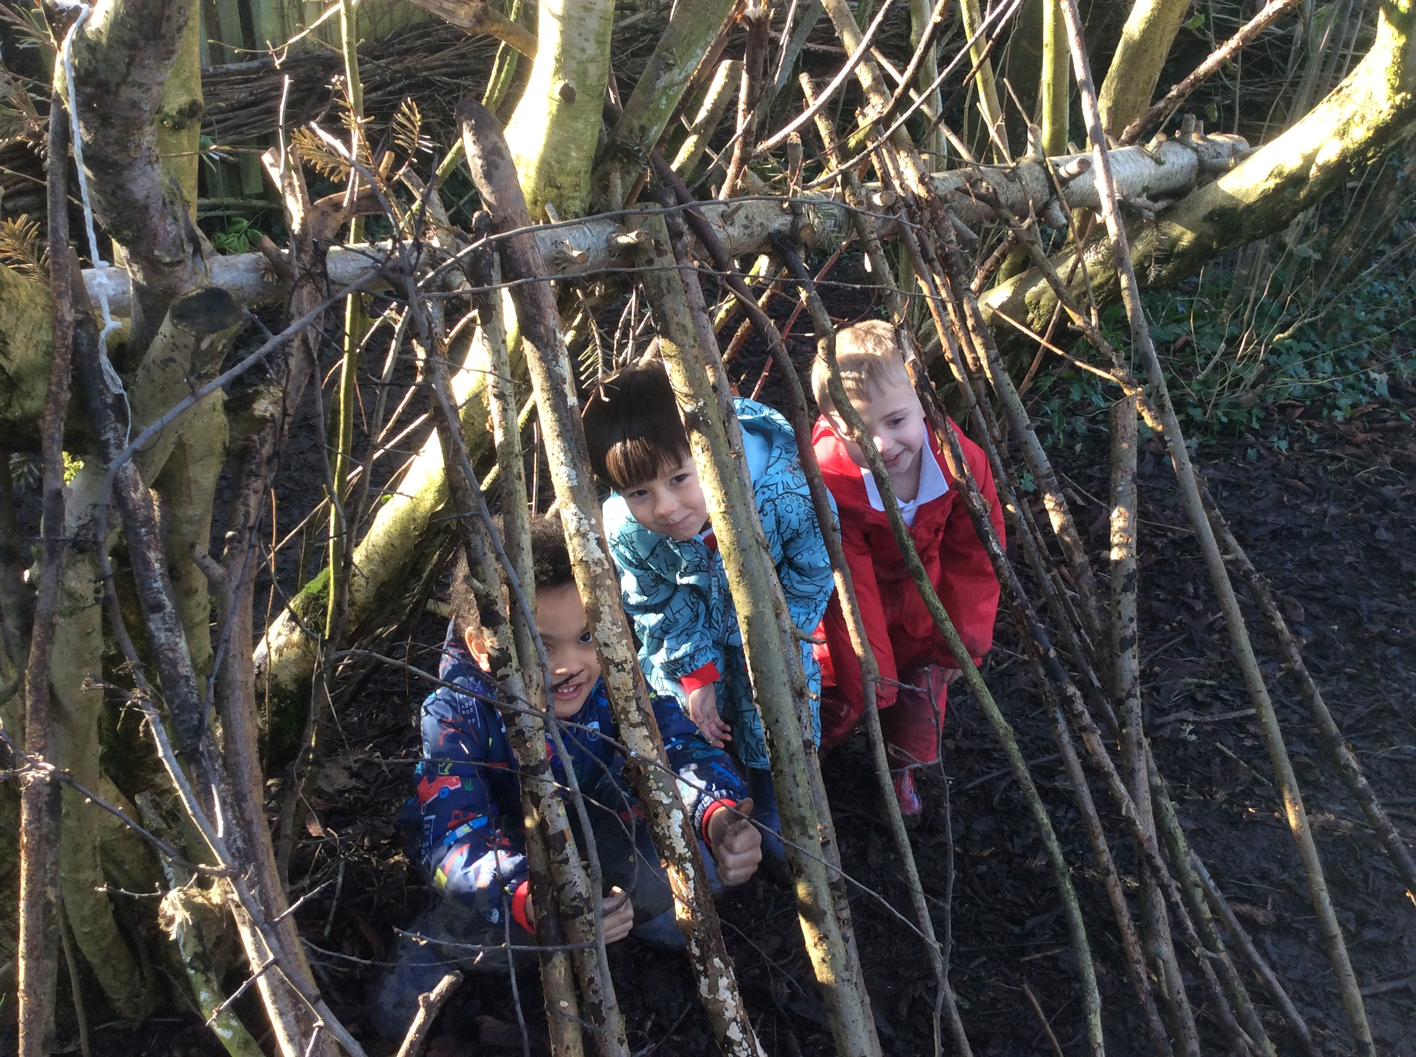
Once in school
We will find out what the children already know and can do and use this information to help us develop a learning environment that suits your child.
They will gradually join in school routines such as playtimes and whole school celebration assemblies once the class is fully settled. Reception will also meet their new Year 6 buddies.

Slide 10
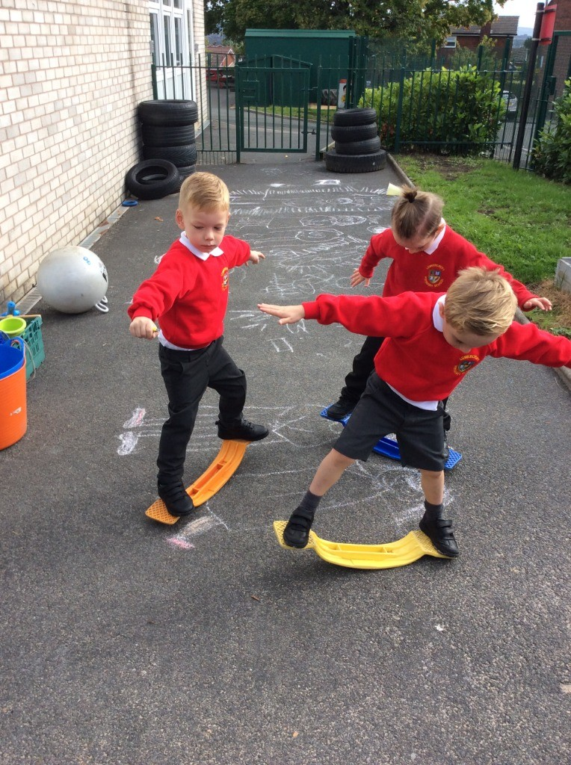
A day in reception
The reception classroom will look very similar to the nursery classroom your child is familiar with. The seven areas of learning are the same for reception children as for nursery children. The areas of learning are:
communication and language.
physical development,
personal. social and emotional development.
mathematics
literacy
understanding the world
expressive arts and design
There are lots of different areas inside and out for your child to learn and play in.
Sand
Water
Mud Kitchen
Large Construction
Reading
Writing
Maths
Painting
Workshop
Role Play
Stage
Dressing Up

Slide 11
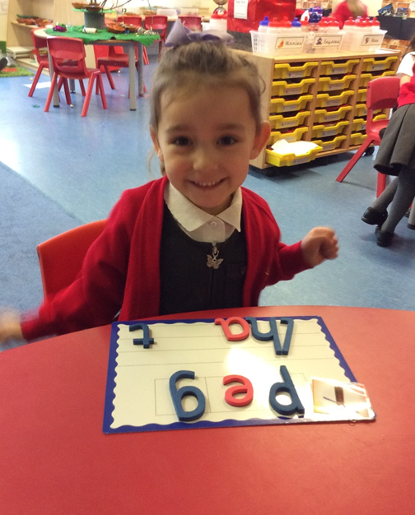
A day in reception
12:15 – 12:45 Playtime
12:45 – 1.00 Registration
1:00 – 1.20 Literacy
1:20 – 2:30 Choosing time
2:30 – 2:45 Circle time
2:45 – 3:00 Storytime
3:00 – 3:10 Collect coats and bags
3:10 - Hometime
8:50 – 9:00 Registration time
9:00 – 9.20 Phonics
9:20 – 10:15 Choosing time
10:15 – 10:30 Playtime
10:30 – 10:50 Maths
10.50 – 11.30 Choosing time
11:30 – 12:15 Lunch in the hall

Slide 12
Reception curriculum

Slide 13

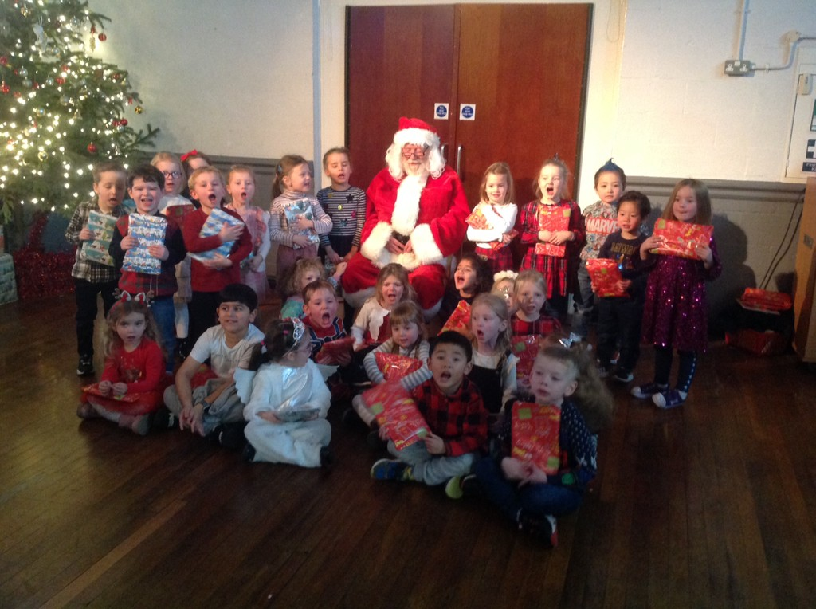
“How will I know how my child is getting on?”
Parents’ evening – twice a year
Information evenings – phonics and reading
Curriculum information events
Stay & Play sessions – twice a year
Drop off and pick up – open door policy
Email via website – class page
Make an appointment – ring office to book
If you have any questions or concerns please don’t hesitate to speak to a member of staff.

Slide 14


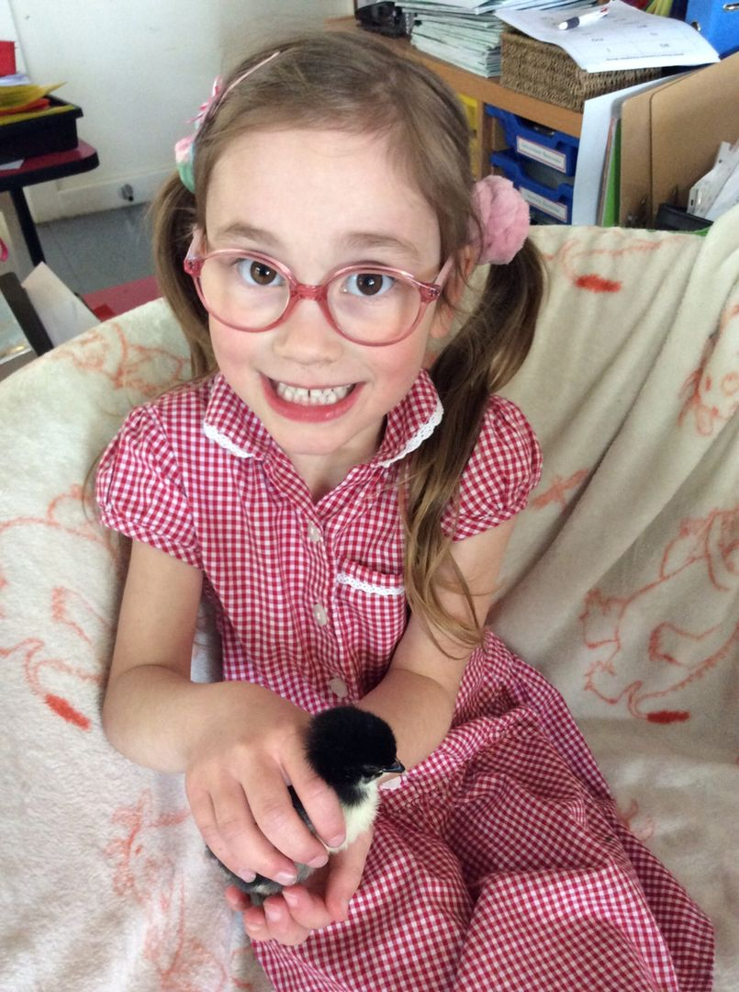
Seesaw and teachers2parents
Throughout school each class teacher communicates with families using the online learning platform SeeSaw.
Children are able to upload their own work in class and teachers are able to share photographs and memorable moments with those at home.
Seesaw can be downloaded on a smart phone or tablet without charge. Please look out for a request from us for your details!

Slide 15

We look forward to getting to know you and your child and working together to make their first year at Lowercroft a fun, happy and positive learning adventure!

